Slide 1


ADVENTURE WORKS CYCLES
DATA ANALYTICS PROJECT OVERVIEW
From Numbers to Narratives!
-Presented by Group 2

Slide 2
OUTLINE
Team details
Summary
Excel dashboard
Power bi dashboard
Tableau dashboard
Sql ANALYSIS
Project insights
Suggestions
Key takeaways

Slide 3
our team
Name | E-mail | Phone
Yogita Awari | yogitaawari2802@gmail.com | 7020894686
Mehmanzai Matheen Ahmed Khan | amatheen553@gmail.com | +91 9652240664
Babita Kumari | shekharshruti1507@gmail.com | 8431511861
Meka Sri Sai Naga Prathyusha | mekaprathyusha999@gmail.com | 9989644628
Farhan Abdul Hafiz Shaikh | farhan19072004@gmail.com | 9930841046
Rohen Joseph Bessy | rohenbessy990@gmail.com | 9074062216
Jarpula Rama Krishna | jarpularamakrishna4@gmail.com | 9347033469

Slide 4
Summary
Objective: To analyze Adventure Works Cycles’ sales data and provide actionable insights using modern BI tools.
Approach: Excel, Power BI, Tableau, and SQL were applied to clean, visualize, and interpret KPIs.
Focus Areas: Dashboards highlight overall sales trends, regional performance, product insights, and customer metrics.
Key Outcome: A consolidated view of sales performance that supports data-driven decision-making and growth strategies.

Slide 5
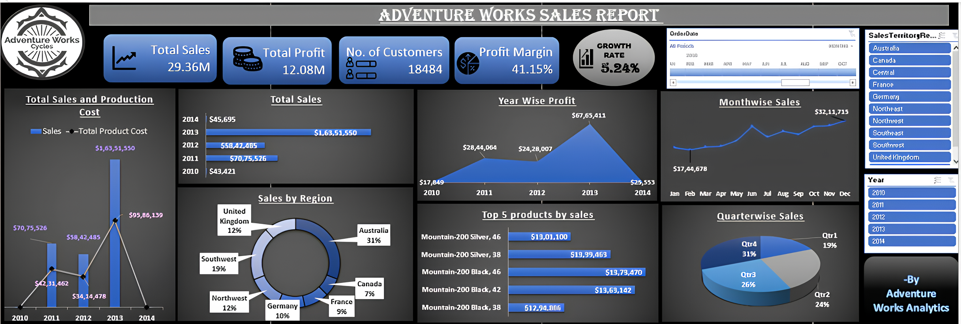
Excel dashboard

Slide 6
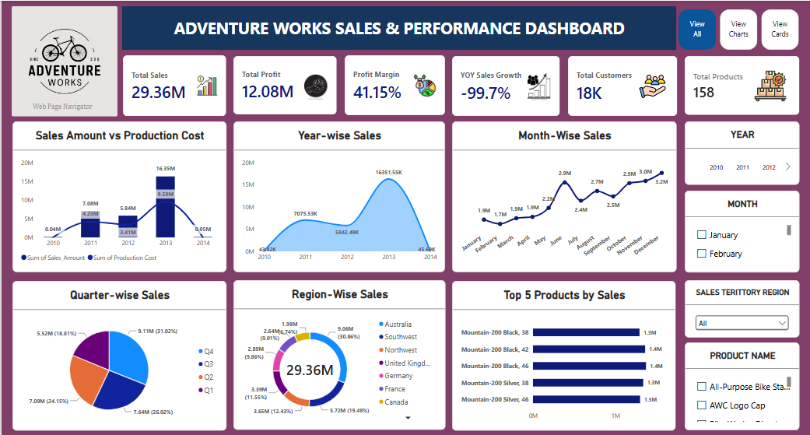
Power bi dashboard

Slide 7
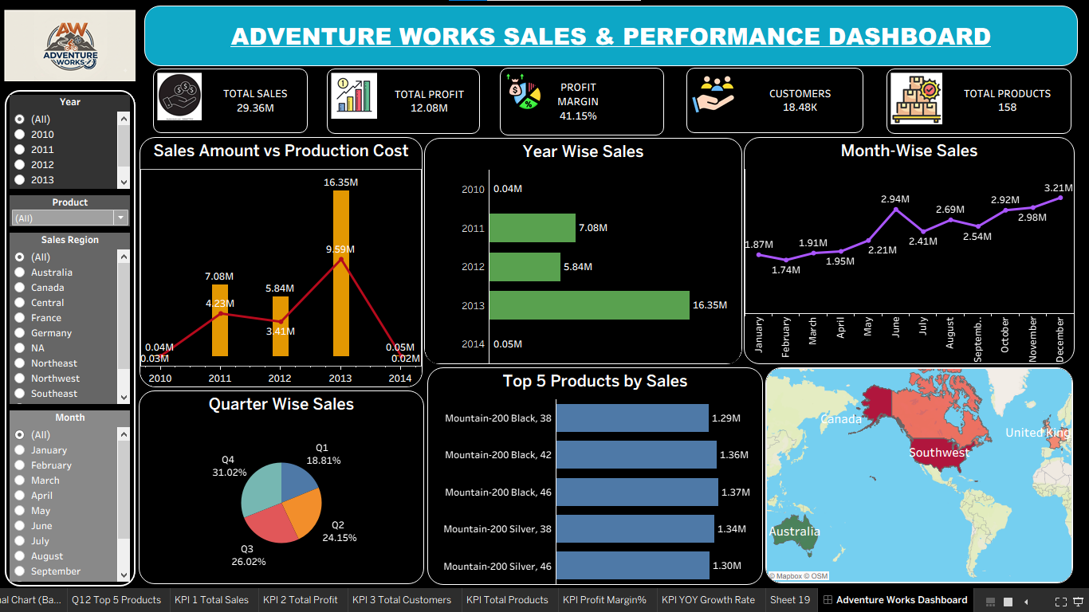
Tableau dashboard

Slide 8
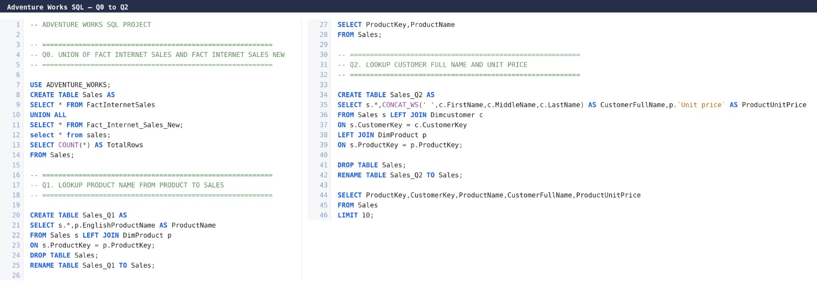
Sql Analysis

Slide 9
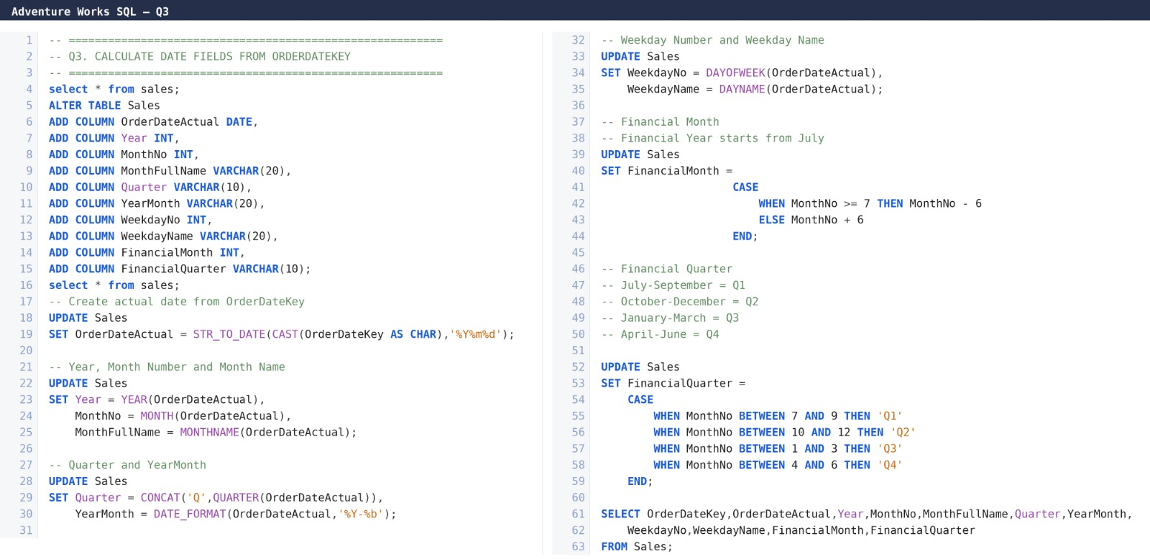

Slide 10
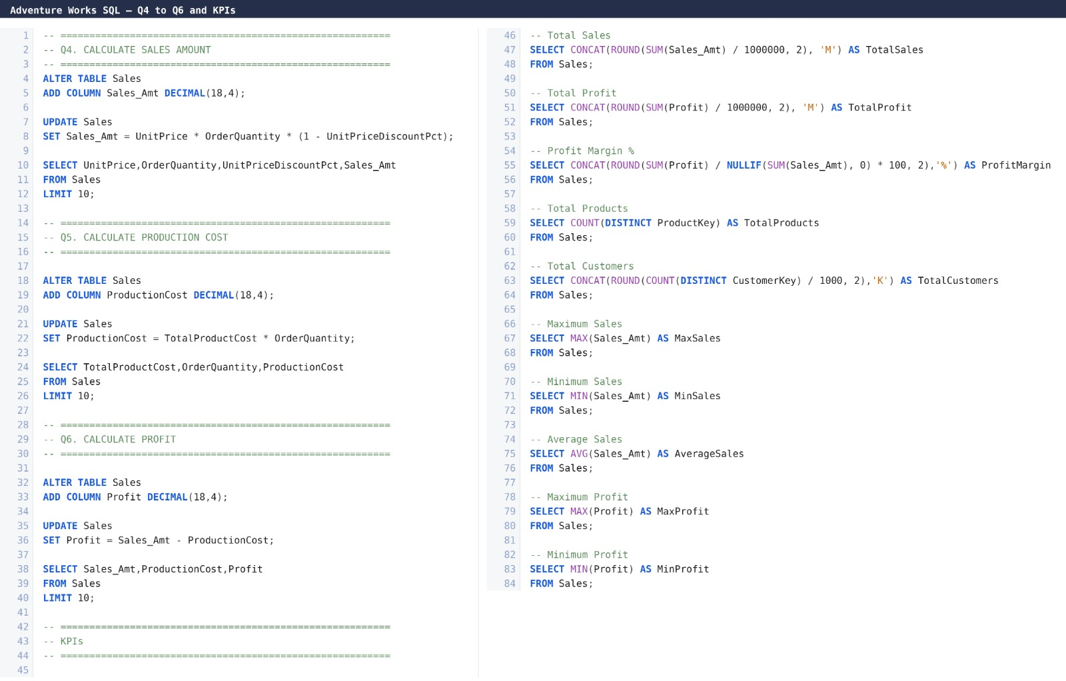

Slide 11
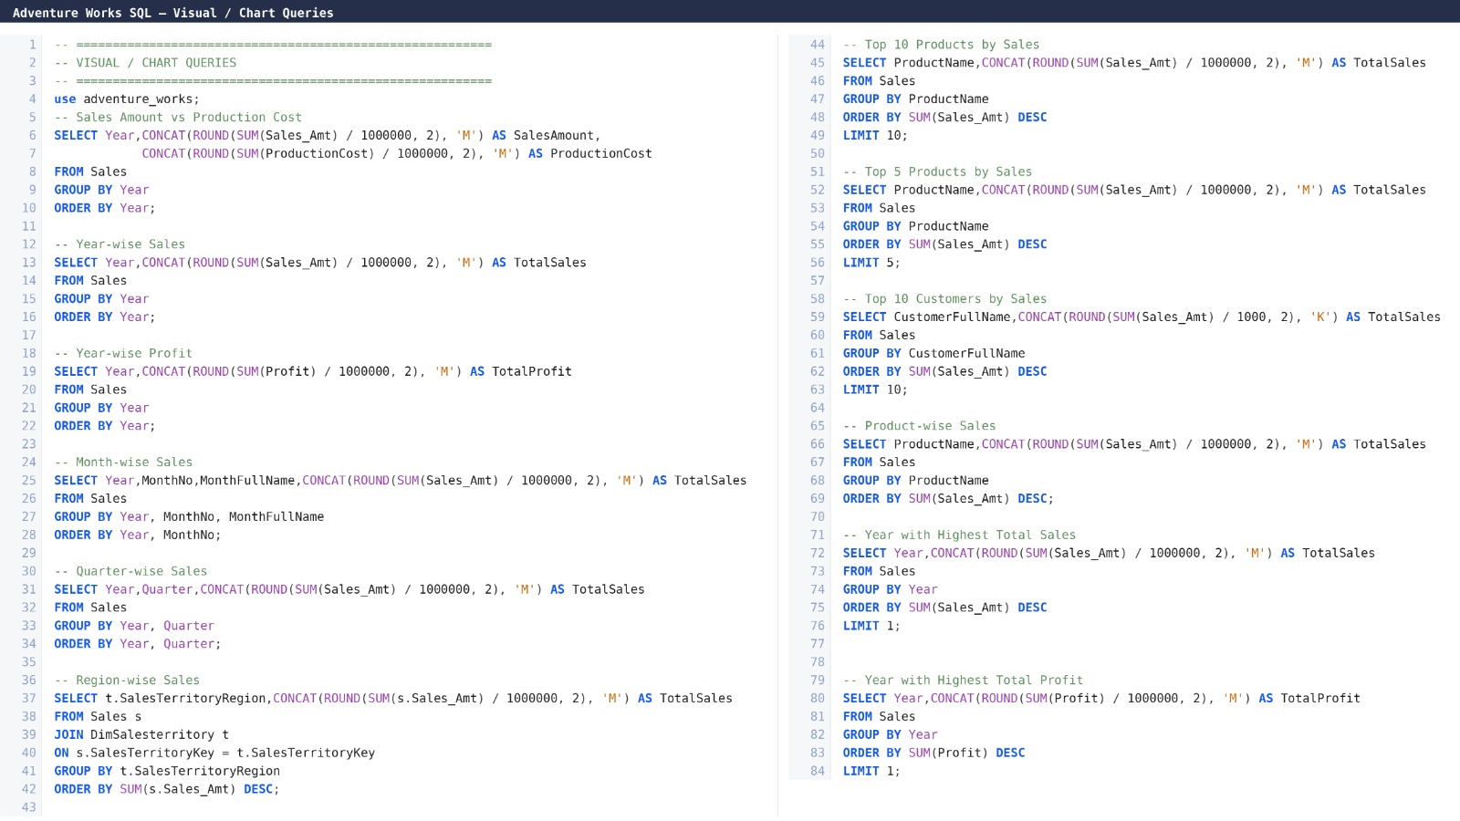

Slide 12
Project insights
Sales Trends:
Sales peaked in 2013, showing strong growth compared to earlier years.
Profit Analysis:
Profit margins remained healthy (~41%), with 2013 delivering the highest profit.
Regional Performance:
Australia contributed the largest share (31%), while Canada and France had relatively smaller shares.
Product Insights:
Mountain-200 series bikes dominated top sales, consistently appearing in the top 5 products.
Customer Metrics:
Over 18,000 customers, with steady growth, indicating strong market penetration.

Slide 13
extended insights
Yearly Volatility:
Sharp fluctuations across years highlight possible external market or internal operational issues.
Profit vs. Cost:
Rising production costs alongside sales growth observed in 2013.
Product Concentration:
Overdependence on Mountain-200 series is both a strength (brand loyalty) and a risk.
Regional Dependence:
Heavy reliance on Australia creates risk if demand falls there.
Seasonal Trends:
Quarter 4 (Oct–Dec) accounted for the highest sales (31%), suggesting strong year-end demand.

Slide 14
Suggestions
1. Regional Focus
→ Strengthen presence in Australia & Southwest
→ Explore growth in Canada & France
2. Product Strategy
→ Expand Mountain‑200 series
→ Introduce bundled offers & new variants
3. Customer Engagement
→ Launch loyalty programs
→ Personalized offers for retention

Slide 15
Suggestions
4. Seasonal Promotions
→ Target Q4 demand with festive campaigns
→ Bundle deals during peak season
5. Operational Efficiency
→ Optimize production costs
→ Improve supply chain management
6. Data‑Driven Decisions
→ Continue using BI tools (Excel, Power BI, Tableau, SQL)
→ Monitor KPIs in real time

Slide 16
Key takeaways
Data-Driven Insights – BI tools converted raw sales data into actionable intelligence.
Product Dependence – Heavy reliance on Mountain‑200 series is both strength and risk.
Profitability – Healthy margins (~41%), but rising costs highlight efficiency gaps.
Regional Insights – Australia & Southwest dominate sales; Canada & France underperform.
Customer Base – 18,484 customers with 5.24% growth; expansion needed for sustained growth.
Seasonal Demand – Q4 consistently highest (31%); festive promotions are critical.

Slide 17
THANK YOU!
Turning Insights into Impact!!

